Slide 1


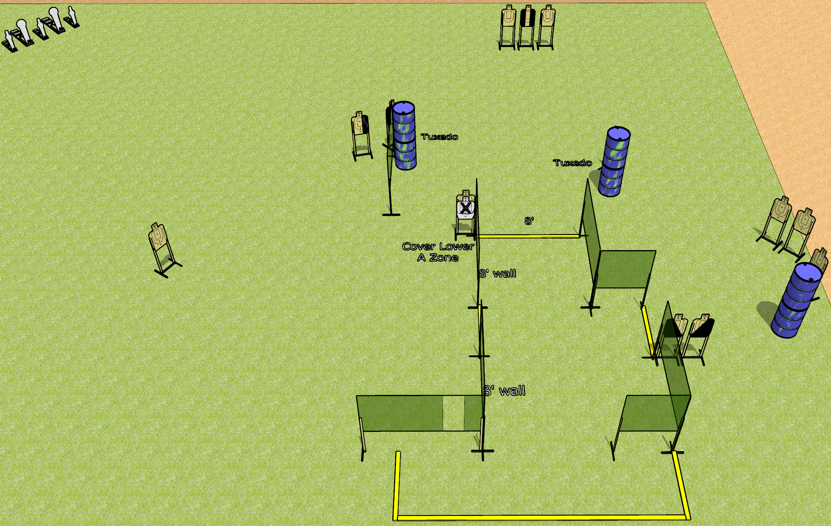
 | Dothan Gun Club – USPSA Match Silly String Course Designer : Drew Coleman
Round Count 31 rounds 13 USPSA 3 mini poppers, 2 colt poppers
Equipment List 13 wall feet 4 medium fault lines 3 tuxedos, 2 diagonal

Slide 2
Silly String
Written Stage Briefing
Silly String is a 31 round, 155 point, Comstock course of fire. There are 13 USPSA targets, 3 mini poppers, and 2 colt poppers. The best 2 hits on paper will score, and steel must fall to score. The start signal is audible.
Handgun start position is anywhere outside the shooting area, wrists below belt. Handgun is loaded and holstered.
PCC start position is anywhere outside the shooting area, stock on belt. Loaded carbine is held with both hands, safety on.
On start signal, engage targets as they become available from within the shooting area.

